Slide 1
ArchiMate®
Business Layer
Notes:
0:00

Slide 2

BUSINESS
Language
Notation
Deliverables
Who are you?
What’s wrong?
How do we fix it?

Slide 3
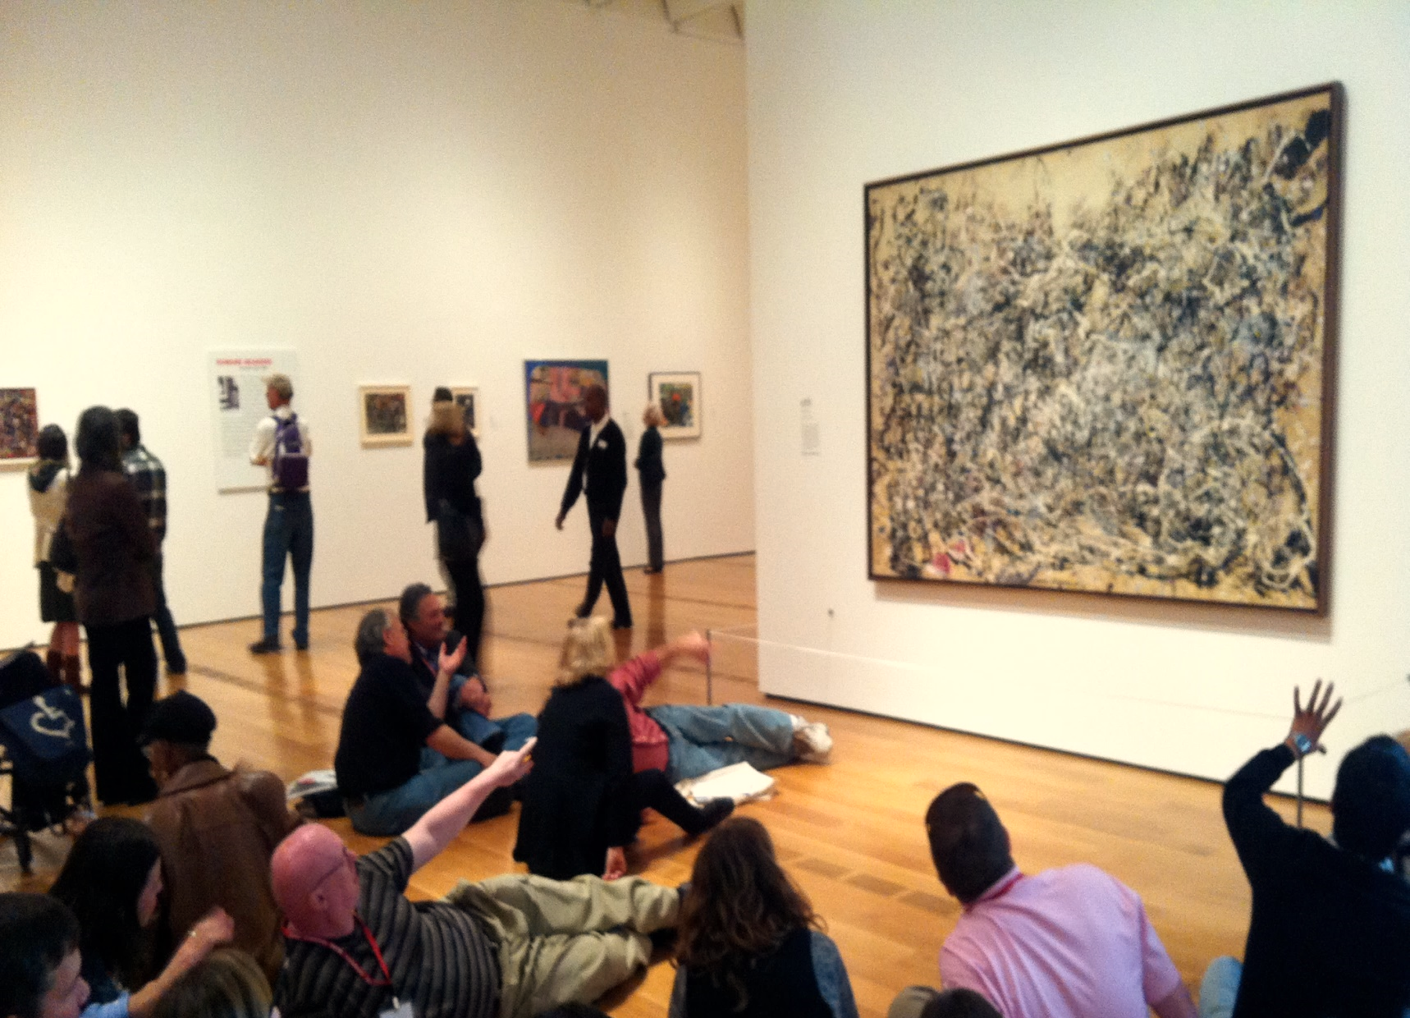
Who makes up the business?
How is it structured?
What can we do?
Who is assigned to do what?
How do they structure tasks?
Who makes use of my resources?
How are they turned into product?
FORM
AUDIENCE
MESSAGE

Slide 4
Application Viewpoints
Application Behaviour
Application Co-operation
Application Structure
Business Viewpoints
Organization
Actor Co-operation
Business Function
Business Process
Business Process Co-operation
Product Viewpoint
Notes:
Now?
Audience?

Slide 5



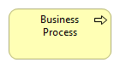
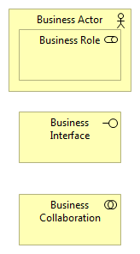
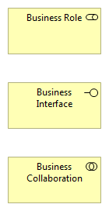
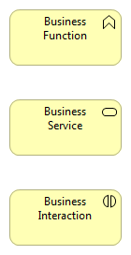
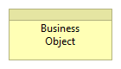
ACTIVE
BEHAVIOUR
PASSIVE
PERFORMS
ON
OFFERS
PERFORMS
ON
Notes:
ROLE = COMPONENT – what do YOU think?
ACTOR – one is the resource itself, one is the “responsibility” for it
ROLES can perform FUNCTIONS AND PROCESSES
Cast your mind back to the APPLICATIONS – same thing with a few exceptions.
We have BUSINESS PROCESS in addition to BUSINESS FUNCTION. And we have a BUSINESS OBJECT instead of a DATA OBJECT.
We also have a BUSINESS ACTOR and BUSINESS ROLE instead of an APPLICATION COMPONENT.

Slide 6
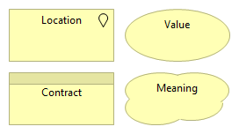

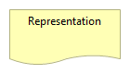
Notes:
Here are three more – we won’t look at these today.

Slide 7
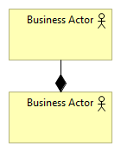

Assigned a role
Uses things
Part of a group
Acts on things
Like someone else
Notes:
Let’s start by being clear about ACTORS. They’re the CLOSEST we get to the APPLICATION COMPONENT – that’s you and me!
Notice that they can be PART OF one another.

Slide 8
I own you
FULL
When I die
you will die
You have me
When I die
you will go on
NONE
If the team
is destroyed
so are you
If the team
is destroyed
you will go on
You are part
of the team
The team
has you
A is part of B
B is composed of A
A is aggregated by B
B aggregates A
COMPOSITION
AGGREGATION
Notes:
The AGGREGATION relationship says – hey – this thing is made up of these other things.
The COMPOSITION relationship is different. Here the parent object has the ADDED RESPONSIBILITY of the LIFECYCLE of those parts.
By extension – there can only be one owner – so A can only be PART OF one other thing.
COMPOSITION – STRONGER than AGGREGATION
Back to ACTORS then – an ACTOR can be AGGREGATED or they could be PART OF – which one are you?!

Slide 9
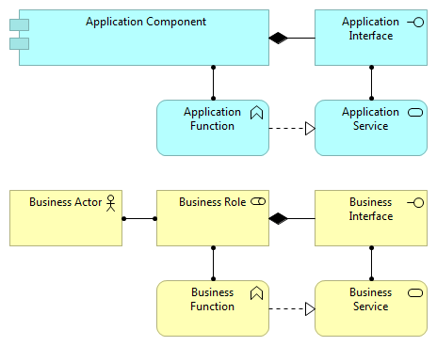
This is what this carries out
This is what fulfils this
This is what offers this
This performs this
A is assigned to B
B is assigned from A
ASSIGNMENT
Notes:
While we’re opening up RELATIONSHIPS between elements – let’s stop off at ASSIGNMENT.
ASSIGNMENT connects ACTIVE elements to BEHAVIOURAL elements
That is: it connects our CHEF to the COOKING.
But wait – CHEF isn’t a person – you and me are people – we’re the ACTORS. And ArchiMate knows that. So there is a differentiation.
At the upper right, I have a COMPONENT assigned to a FUNCTION
For business it’s the same but it’s just a ROLE is assigned to a FUNCTION
As before, when we know all the FUNCTIONS a ROLE is assigned to perform, we get the JOB DESCRIPTION!
So, if you like, ROLE has a sense of RESPONSIBILITY FOR GETTING THE JOB DONE – it’s something the BUSINESS is CAPABLE OF DOING
In some situations, you might therefore IGNORE ACTOR and just use ROLE. It’s certainly less complicated to explain…

Slide 10
Draw an organisation chart in Archi Use both aggregation and composition
Notes:
What do you think of the example?

Slide 11
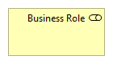
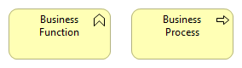
Duties
Sequences
Notes:
Now we’ve looked at the ACTIVE elements, let’s look at the BEHAVIOUR elements.
In the Business Layer we have FUNCTION – just like before. But let’s ramp this up a bit!
We also have this element: the BUSINESS PROCESS element.
While both BUSINESS and APPLICATION FUNCTIONS have a sense of what “DUTY” someone has, the additional PROCESS element gives you a placeholder for documenting SEQUENCES of events and activities. And THAT is the connection to BPMN.
This is ALSO in the APPLICATION LAYER – they’re APPLICATION PROCESSES. And you use them in exactly the same way but while here we’re talking about some sequence of things performed by a ROLE, in the world of the APPLICATION we’re talking about a sequence performed by…
QUESTION??
ANSWER = Application Component

Slide 12
“Sequence of activities required to design, produce, and provide a specific good or service, and along which information, materials, and worth flows.”
Notes:
Just to make this really clear – the PROCESS elements describe… [READ]
For those who know, what we’re talking about here are Value Streams – about RESULTS
A little note, too, again on the RELATIONSHIPS between elements: FLOWS are about information – TRIGGERS are about order. If you do think about using them to glue together PROCESSes for example, be cautious which one you pick.

Slide 13
SUPPORT
ADMIN & FINANCE
Legal / Accounting / Financial Management
VALUE
WORKFORCE MANAGEMENT
Personnel / Lay Recruitment / Training / Staff Planning
PROD & TECH
Product & Process Design / Production Engineering / Market Testing / R&D
PROCUREMENT
Supplier Management / Funding / Subcontracting / Specification
PRIMARY
INBOUND LOGISTICS
OPERATION
OUTBOUND LOGISTICS
SALES & MARKETING
CUSTOMER SERVICES
Quality Control
Receivables
Raw Materials
Control
Supply Scheduling
Manufacturing
Packaging
Production Control
Quality Control
Maintenance
Finishing
Order Handling
Despatch
Delivery
Invoicing
Leads
Promotions
Sales Analysis
Market Research
Warranty
Maintenance
Education
Complaints
Notes:
Now you don’t have to REINVENT THE WHEEL when it comes to functions.
You will find EXISTING NAMES AND DEFINITIONS FOR APPLICATION FUNCTIONS in places like TOGAF AND WIKIPEDIA
And in BUSINESS ANALYSIS there’s models like this one from PORTER
Groupings of skills, knowledge, expertise
At this level, you don’t need to do extreme analysis and redefine things – just copy forward!

Slide 14

PROCESSES
are defined by looking at
PRODUCTS & SERVICES
the organization offers
FUNCTIONS
are defined by viewing the
RESOURCES
of the organization
Notes:
How would you identify each type if you were doing business analysis or – in the APPLICATION LAYER – some kind of reverse engineering or system design?

Slide 15
PROCESSES
are about
BEHAVIOUR
FUNCTIONS
are about
CHARACTER
Notes:
PROCESSES = ORGANIZATION
FUNCTIONS = SURVIVAL

Slide 16

“a process/function may be performed by a single role”
Notes:
What does this rule mean?
A function “is performed by a single role within the organization”
“A business role may be assigned to one or more business processes or business functions”

Slide 17
Cooking Cook soup Washing up Wash a fish kettle Polish copperware Place veg order Stock Control
CHEF
✓
Notes:
GARY!!

Slide 18
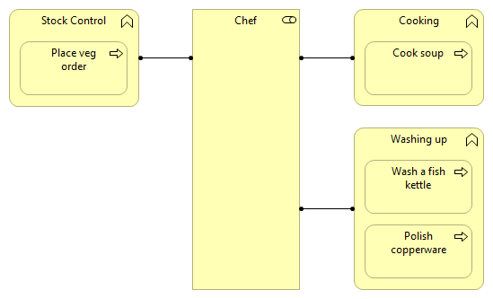
✓

Slide 19
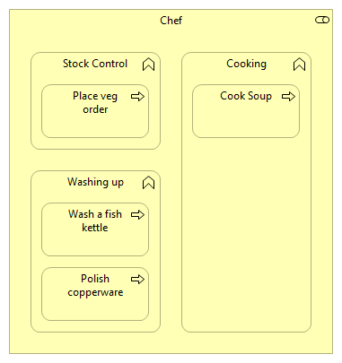
✓
Notes:
This looks close to a JD
NOTE – NESTED here = ASSIGNMENT!

Slide 20
Chef Kitchen Porter Soux Chef Veg Chef Pastry Chef Fireman Maître D’
COOKING
✗

Slide 21
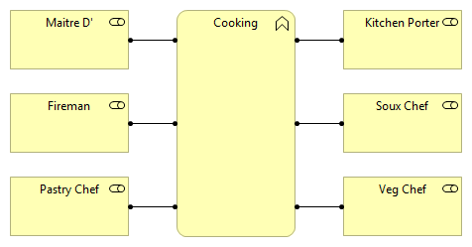
✗
Notes:
What’s the real message here?
It’s that these ROLES ALL WORK TOGETHER
It’s a COLLABORATION

Slide 22

DISTINGUISH BETWEEN behaviour that is performed by a SINGLE structure element or COLLECTIVE behaviour that is performed by a collaboration
Notes:
P4 “COLLABORATION AND INTERACTION” rule

Slide 23
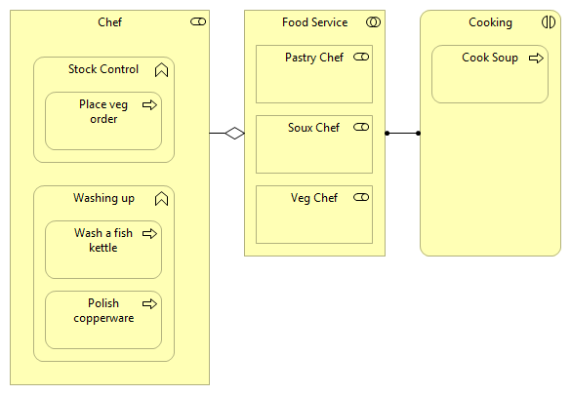
✓
Notes:
IT’S A COLLABORATION
Is this what we REALLY mean?? Is “Cook Soup” really a collaboration between these roles?

Slide 24
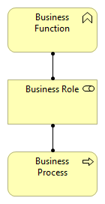

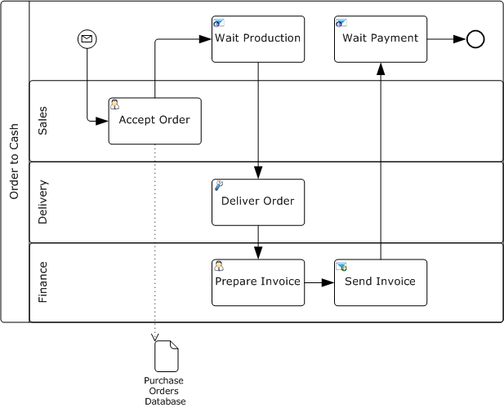
Participants
Any “business entity” or “business role” that controls or is responsible for a process.
Pool
A container for the “activities, elements, events, gateways, and sequence flows” of one Participant
Lane
Organise and categorize according to “internal roles … systems … and internal departments.”
Notes:
BPMN – how do we CORRELATE?
REMEMBER collaborations versus processes
REMEMBER part of options

Slide 25
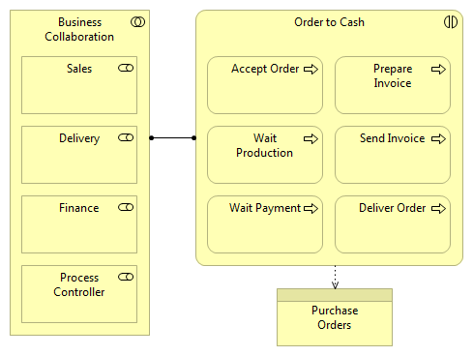
Notes:
Archimate is NOT BPMN
It’s about BROAD MESSAGES – not the detail
As you would use UML in Application Layer, you would use BPMN in Business Layer

Slide 26
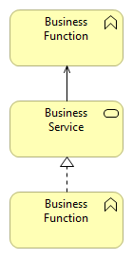
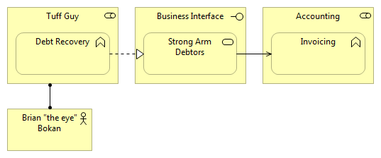
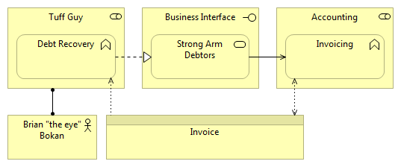
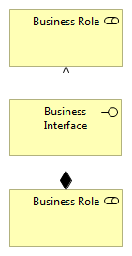
Notes:
VOLUNTEER : interpret
WHICH are ACTIVE / BEHAVIOURAL / PASSIVE
What COLLABORATIVE elements aren’t in this diagram?

Slide 27
Group 1 Draw a Business Function Viewpoint Group 2 Try a Business Process Viewpoint
Notes:
What do you think of the example?

